Slide 1
Object Oriented Thinking

Slide 2
Objectives
Define OO principles like
encapsulation
Abstraction
Inheritance
polymorphism
UML to represent a class.
Notes:
Faculty notes:
Briefly review module learning objectives with the participants and ask if they have any questions.
Module duration:
Experience: 120 Min
Application: 60 Min
Demonstrate: 60 Min

Slide 3
Procedure-Oriented Programming
Emphasis is on algorithms
Large programs are divided into smaller programs known as functions
Most of the functions share global data
Data moves openly around the system from function to function
Functions transform data from one form to another
Employs top-down approach in program design
Works great for smaller systems (<50,000 LOC) but fails for larger systems
Complex data, behavioural relationships
Increased coupling
Notes:
Faculty notes:
Discuss how they have coded in C Programming.

Slide 4

Object-Oriented Programming
OOP is a programming paradigm that focuses on the objects in a software system similar to that of real world.
Objects communicate with each other by sending messages.
Notes:
Faculty notes:
Explain how you interact with Objects available in Class room [ Projector, Laptop, etc] by sending messages like “on”, “off”, etc

Slide 5
Object Oriented Programming central concepts
Abstraction
Modularity
Encapsulation
Inheritance
Polymorphism

Slide 6
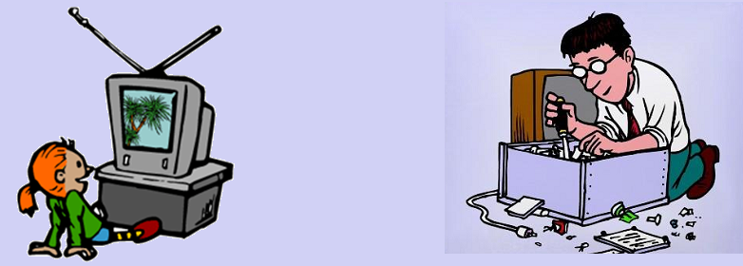
Abstraction
Emphasize details that are significant to the viewer and suppress details that do not matter
An abstraction denotes the essential characteristics of an object relative to the perspective of the viewer
TV viewer
TV Technician

Slide 7
Abstraction
Abstraction is the process of capturing the essential while suppressing the detail
An abstraction is encapsulated by a well-defined interface, which defines how the abstraction can be used
A car's interface consists of steering wheel, accelerator, brake, etc.
We do not need to continually adjust the fuel/air mixture to drive the car - it is hidden from us.

Slide 8
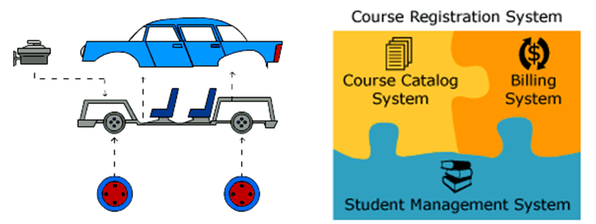
Modularity
A program is partitioned into individual components to reduce the complexity
Notes:
Faculty notes:
Modularity is the property of a system that has been decomposed into a set of cohesive and loosely coupled modules.
When designing a complex software system, it is essential to decompose it into smaller parts, each of which we may then refine independently
Explain how in Online shopping different components exist like: Customer Module, Product module, Order Module and Authentication Module

Slide 9
Encapsulation
Encapsulation is an information hiding mechanism that hides detailed internal information about an abstraction
The mechanical devices of your car are encapsulated (hidden) by the chassis of the car
This insulation of the data from direct access by the program is called data hiding or information hiding
Eliminates direct dependencies on the implementation
Notes:
Faculty Notes:
Programming languages enforce abstraction via encapsulation

Slide 10
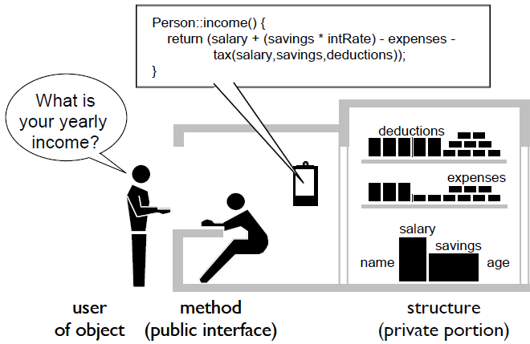
Encapsulation
When the user object asks for the yearly income, the person represented as public interface is going to do all the computation by himself.
The user object does not know that the person represented by public interface has considered SAVINGS, TAX, etc.
My Total Income:
SALARY PLUS (SAVINGS * INTERESTRATE)
DEDUCT EXPENSES
DEDUCT TAX ON SALARY, SAVINGS, DEDUCTIONS

Slide 11
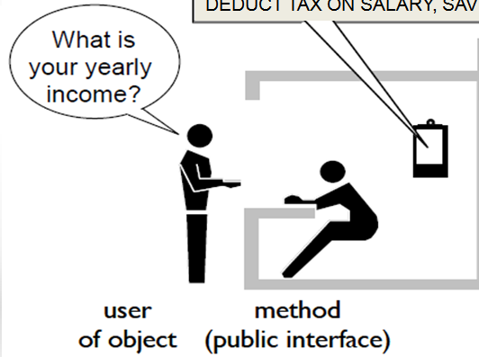


Encapsulation
Now when the user object asks for the yearly income, the person represented as public interface is now asking the secretary about the income.
Secretary give my INCOME REPORT
The secretary is using accountancy package in computer to compute the income.
Notes:
Faculty Notes:
The user object still gets the income report even if internal implementation has changed.

Slide 12
Encapsulation
 | Builder | User
Goal | Create a reusable, maintainable code with an understandable interface | Quickly get and use a code
Approach | Hide structure and implementation details from user. | Examine and use operations exposed through an interface.
Benefits | May change structure and algorithms without affecting user | Understandable interface; can be used without fear of "breaking" object
Costs | Reusability must be carefully planned | Access to data through operations may be slower than direct access
Notes:
Faculty:
Explain the importance of encapsulation from builder and user perspective.
You can explain with some real world example.

Slide 13



Objects
What type of Objects are they?
What are the different states of these objects?
What is the common behavior among them?
Notes:
Faculty Notes:
Ask participants about common behavior and different states of the objects

Slide 14
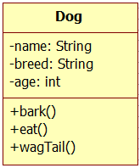
Objects state and behavior
All the objects are of type Dog
Every dog has the following states name, breed and size.
Every dog does the following: barks, eats, sleeps and wags its tail.
This generalization is referred as a Class.
state
behavior
Class
Objects

Slide 15


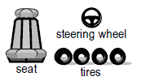

OO Real world and software
Real World
Software
Car
model
chassisNo
regNo
start
stop
turn
accelerate
Objects / instances
myCar
myDadsCar
myFriendCar
myCar
myDadsCar
State
model: Rapid
chassisNo: AE122011
regNo: KA-50-1233
model: WangonR
chassisNo : LK922T3
regNo: KA-04-8222
myCar.start( );
myCar.shiftGear();
myCar.accelerate( );
myCar.turn(LEFT);
myDadsCar.start( );
myDadsCar.stop( );
Behavior
Notes:
Faculty notes:
Compare Real world objects with Software objects

Slide 16
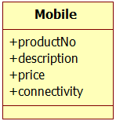



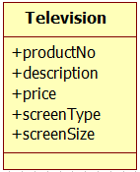
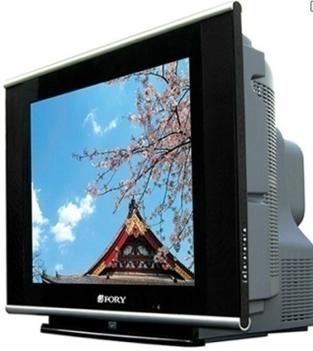
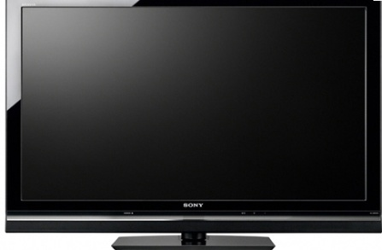
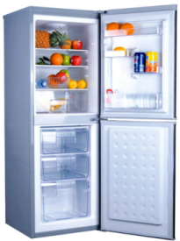
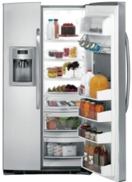
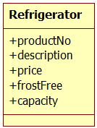
Generalization
Different products and their attributes
Notes:
Faculty notes:
We have different types of products which share common attributes like productNumber, description and price.

Slide 17
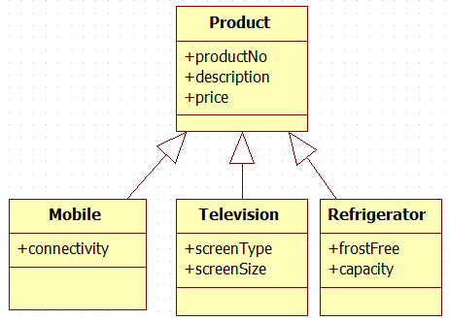

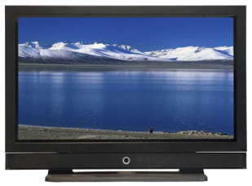
Inheritance
Move the common attributes and behavior up the tree.
Specialization
Generalization
productNumber : 544
description: G Android Mobile
price: 25000.55
Connectivity: 3G
productNumber : 122
description: ABC TV
price: 65000.55
screenSizeInInches: 42
screenType : LCD
Notes:
Faculty notes:
Explain DRY (Don’t Repeat Principle) : Avoid duplicate code by abstracting out things that are common and placing those things in a single location. Also explain the various ways of achieving DRY principle.
Explain in brief Liskov Substituton Principle

Slide 18
Inheritance (is-A Relationship)
Method of reuse in which new functionality is obtained by extending the implementation of an existing object
The generalization class (the super class) explicitly captures the common attributes and methods
The specialization class (the subclass) extends the implementation with additional attributes and methods

Slide 19
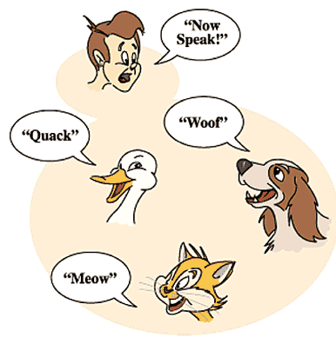
Polymorphism
Polymorphism is the ability of different objects to respond in their own unique way to the same message
Notes:
Faculty notes:
For the same message “Now Speak”, duck “quack”, Cat says “Meow” and Dog says “Woof”.

Slide 20
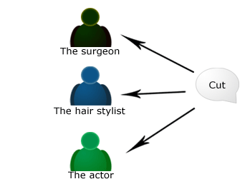
Polymorphism Question
How do they react if someone says “CUT” to these people?
Notes:
Faculty notes:
For the same message “cut”:
The Surgeon would begin to make an incision (slit).
The hair stylist would begin to cut someone’s hair.
The actor would abruptly stop acting the current scene, awaiting directorial guidance.

Slide 21
UML Class diagram

Slide 22
UML Class diagram
The class diagram is a static diagram.
It represents the static view of an application.
The class diagrams are the only diagrams which can be directly mapped with object oriented languages and thus widely used.
Notes:
Faculty notes:
Class diagram is not only used for visualizing, describing and documenting different aspects of a system but also for constructing executable code of the software application.

Slide 23
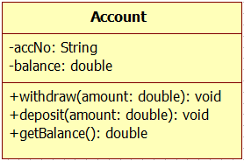
UML Class diagram
The UML representation of a class is a rectangle containing three compartments stacked vertically.
Notes:
Faculty notes:
The top compartment shows the class's name.
The middle compartment lists the class's attributes.
The bottom compartment lists the class's operations

Slide 24
UML Class diagram
Member Access Modifier
Public (+)
Private (-)
Protected (#)
Package (~)
Static (underlined)
Notes:
Faculty notes:
Tell participants that the access modifiers will be explained in detail during next iteration.

Slide 25
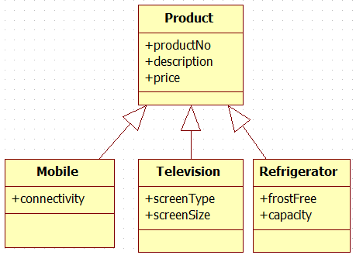
UML Class diagram
Generalization and Specialization is represented using notation:
arrow-head points to the generalized class [ super class ]

Slide 26
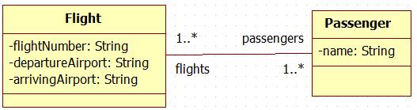
UML Class diagram
Association:
An association is a linkage between two classes. Associations are always assumed to be bi-directional; this means that both classes are aware of each other and their relationship.
A Flight has many passengers who fly frequently, association can be represented as shown below.
Notes:
Faculty notes:
A bi-directional association is indicated by a solid line between the two classes. At either end of the line, you place a role name and a multiplicity value

Slide 27
UML Class diagram
Association
Multiplicity values and their indicators
Indicator | Meaning
0..1 | Zero or one
1 | One only
0..* | Zero or more
* | Zero or more
1..* | One or more
3 | Three only
0..5 | Zero to Five
5..15 | Five to Fifteen

Slide 28

UML Class diagram
Aggregation
Aggregation is a variant of the "has a“ association relationship.
Aggregation can occur when a class is a collection or container of other objects, but where the contained classes do not have a strong life cycle dependency on the container—essentially,
if the container is destroyed, its contents are not destroyed
Notes:
Faculty notes:
Aggregation: draw a solid line from the parent class to the part class, and draw an unfilled diamond shape on the parent class's association end
Department have a aggregation of Employees.
Department does not have the lifetime responsibility for the Employee
An Employee can work in more than one department

Slide 29

UML Class diagram
Composition
The composite (Company) is responsible for the creation and destruction of the component (Department) parts.
An Department object may only be part of one composite (Company). If the composite object (Company) is destroyed, all the component parts (Departments) must be destroyed.
Notes:
Faculty notes:
draw a solid line from the parent class to the part class, and draw an filled diamond shape on the parent class's association end

Slide 30
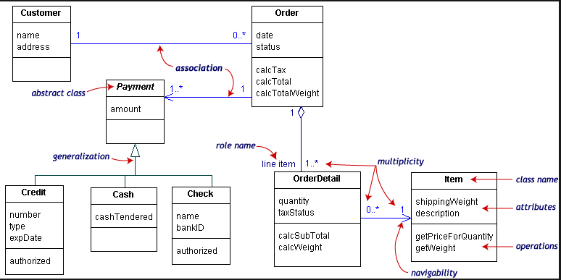
UML Class diagram: Online shopping example
Notes:
Faculty notes:
Ask participants to identify relation between each class.

Slide 31
Quiz: Relationship between classes
Identify the relationship between these classes:
Book Shelf and Books
Components in a Television Set
Orchestra is made up of Musicians
Building is made up of rooms
Brochure is made up of Products
Account and Savings Account

